Slide 1
Clinical uses of cardiovascular drugs in operating room, What we need to know?
R2 สริตา/ อ. กฤษณะ

Slide 2
Content
Shock
Type of shock
Septic Shock
Anaphylactic Shock
Hypovolemic Shock
Cardiogenic Shock
Obstructive Shock
Hypertensive emergency & urgency in OR
Post-induction hypotension

Slide 3
Shock
Inadequate tissue perfusion
O₂ Demand
O₂ Supply

Slide 4
Organ perfusion
BP = CO x SVR
= ( SV X HR ) X SVR
= ( EDV – ESV ) X HR X SVR
= EDV ( EDV – ESV ) X HR X SVR
EDV
= EDV X EF X HR X SVR

Slide 5
Oxygen delivery
Oxygen delivery = Cardiac output X Oxygen content
Oxygen content = O₂ binding capacity + O₂ dissolve in plasma
O₂ binding capacity = Hb X 1.34 X SpO2
O₂ dissolve in plasma = 0.003 X PaO2

Slide 6
Type of Shock
Hyperdynamic
Distributive
Septic
Anaphylactic
Adrenocortical
Neurogenic
Hypodynamic
Hypovolemic
Cardiogenic
Obstructive

Slide 7
Type of shock | CVP | Pcwp | CO | SVR
Hypodynamic
Hypovolemic | ⬇ | ⬇ | ⬇ | ⬆
Cardiogenic
Lt side | ⬆ | ⬆ | ⬇ | ⬆
Rt side | ⬆ | ⬇ / - | ⬇ | ⬆
Obstructive
Pulmonary embolism | ⬆ | ⬇ / - | ⬇ | ⬆
Cardiac tamponade | ⬆ | ⬆ | ⬇ | ⬆
Hyperdynamic
Distributive | ⬇ | - / ⬇ | ⬆ | ⬇

Slide 8
Septic shock
Vasopressor : Hypotensive despite adequate fluid resuscitation
Norepinephrine = 1 st choice
Dopamine = alternative in non-tachycardia patient
Vasopressin or epinephrine can be added to NE
Inotropic agent : Low CO despite adequate fluid resuscitation and vasopressors
Dobutamine = 1 st choice
Epinephrine = Alternative

Slide 9
Drugs | Pharmacology | Effect | Dosage mcg/kg/min
NE | Alpha >> Beta1 | Strongly increase BP >> HR | 0.02-0.5
Vasopressin | Vasopressin receptor | Increase SVR | 0.03-0.06 U/min
Adrenaline | Alpha, Beta1, Beta2 | Strongly increase HR &BP | 0.02 – 0.5
Dopamine | Alpha, Beta1, Beta2 , Dopamine1 | Moderate increase BP & HR | 3 - 20
Dobutamine | Beta1 > Beta2 > Alpha | Strongly increase BP >> HR | 2-20

Slide 10
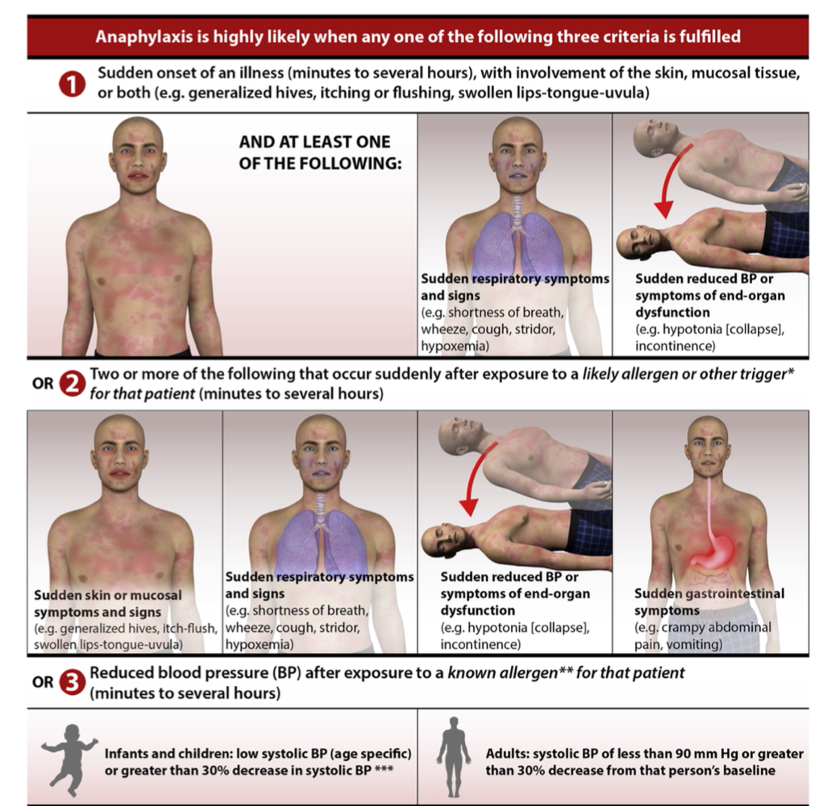
Anaphylactic Shock

Slide 11
Anaphylactic Shock
Epinephrine = 1st line
Initial dose : 0.01 mg/kg of 1:1,000( 1 mg/ml) IM at anterolateral thigh
Maximum : 0.5 mg in adult, 0.3 mg in children
Dose can be repeated every 5 – 15 minutes
Inadequate response -> IV infusion
Refractory hypotension:
Vasopressin
NE
Dopamine

Slide 12
Anaphylactic Shock
Pediatrics
Epinephrine (1:1,000) 1 ml dilute in NSS 100ml = 10 mcg/ml
Start 0.1 mcg/kg/min
Adult
Epinephrine (1:1,000) 1 ml dilute in NSS 1,000 ml = 1 mcg / ml
Start 0.1 mcg/kg/min

Slide 13
Hypovolemic shock
Hemorrhagic shock
Non-hemorrhagic shock

Slide 14
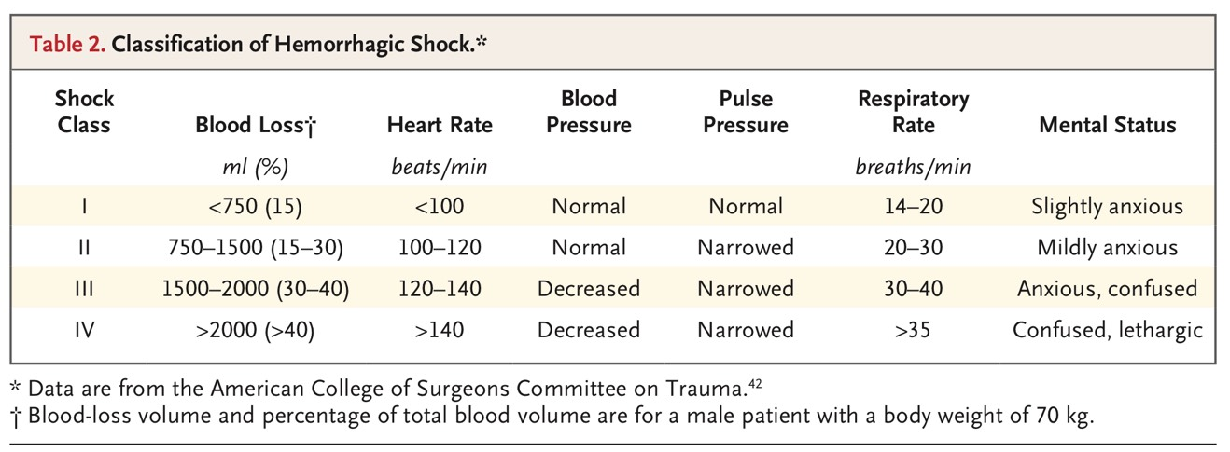
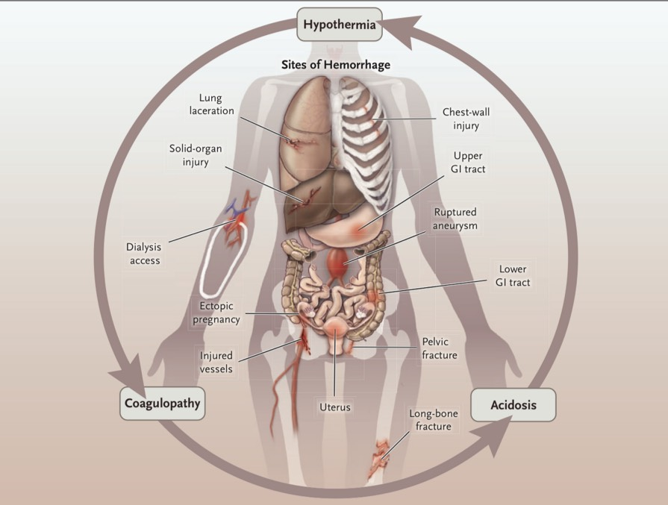
Hemorrhagic Shock

Slide 15
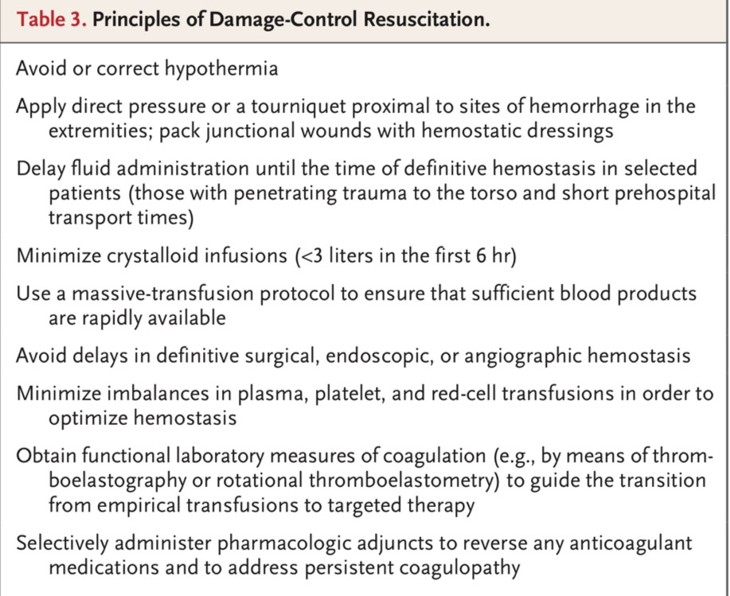

Slide 16
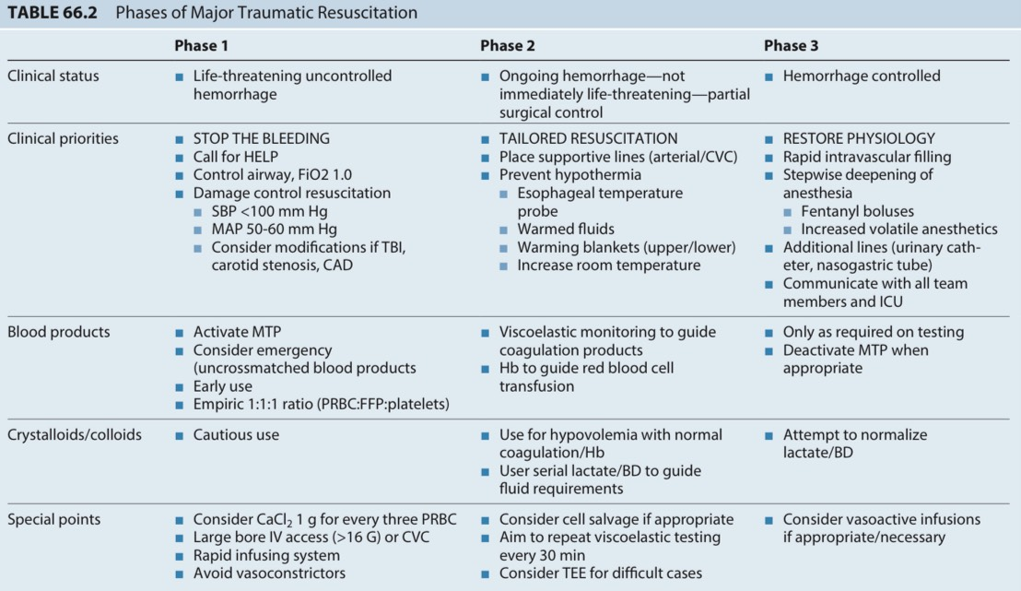

Slide 17
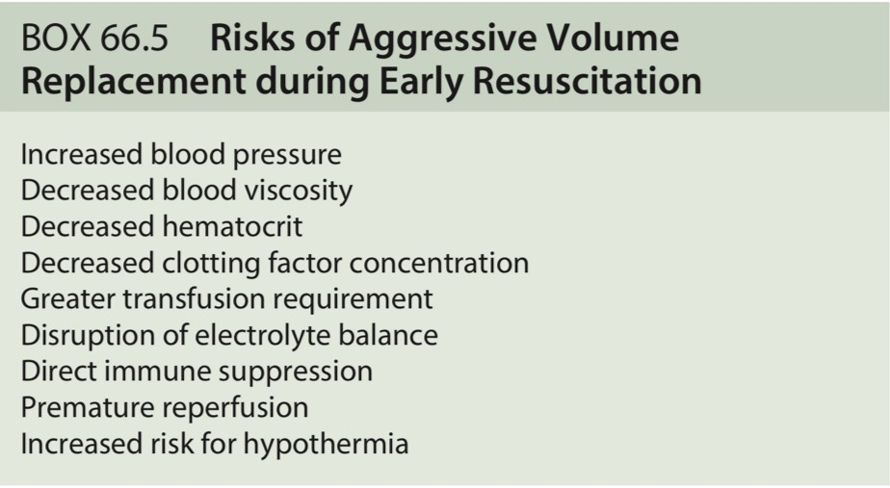
Hemorrhagic Shock

Slide 18
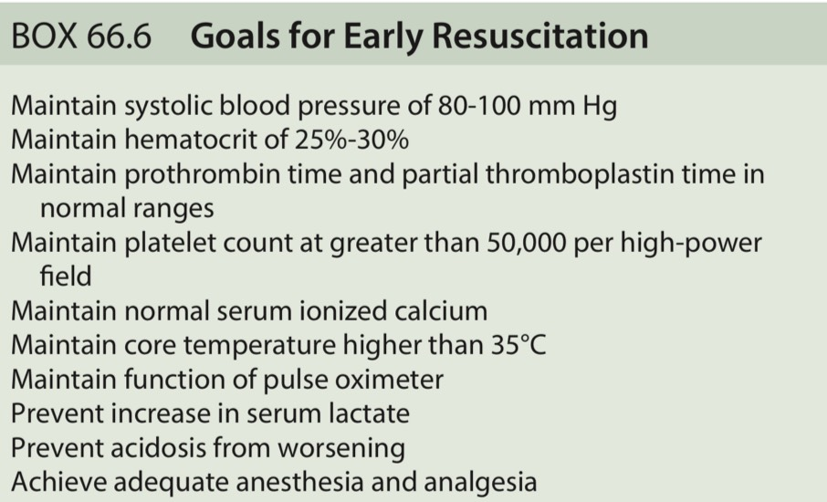
Hemorrhagic Shock

Slide 19
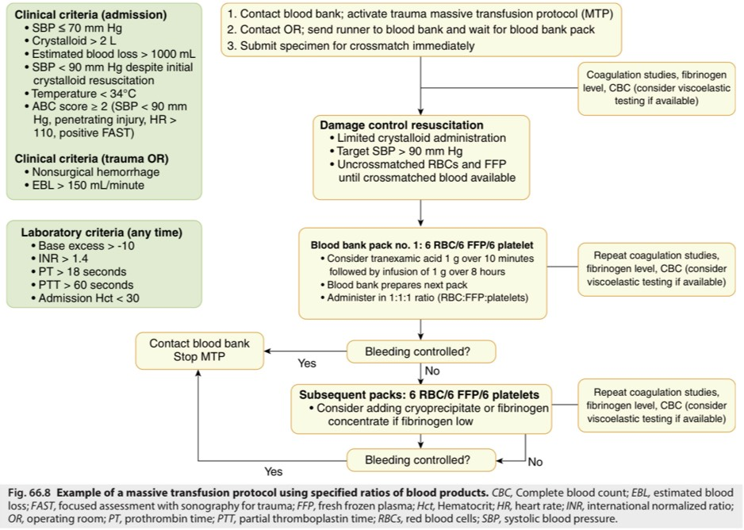

Slide 20
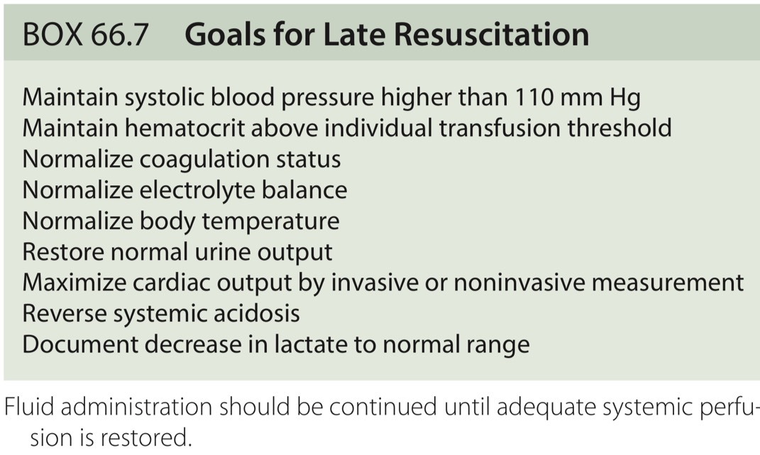
Hemorrhagic Shock

Slide 21
Hemorrhagic Shock: Vasopressor
In addition to fluid administration, vasopressors may be necessary to restore adequate tissue perfusion
Survival was not adversely affected by early use of norepinephrine after failure to restore BP with initial crystalloid fluid of 1000 to 1500 mL

Slide 22
Hemorrhagic Shock

Slide 23
Cardiogenic shock
Left side
Right side
Pulmonary hypertension

Slide 24
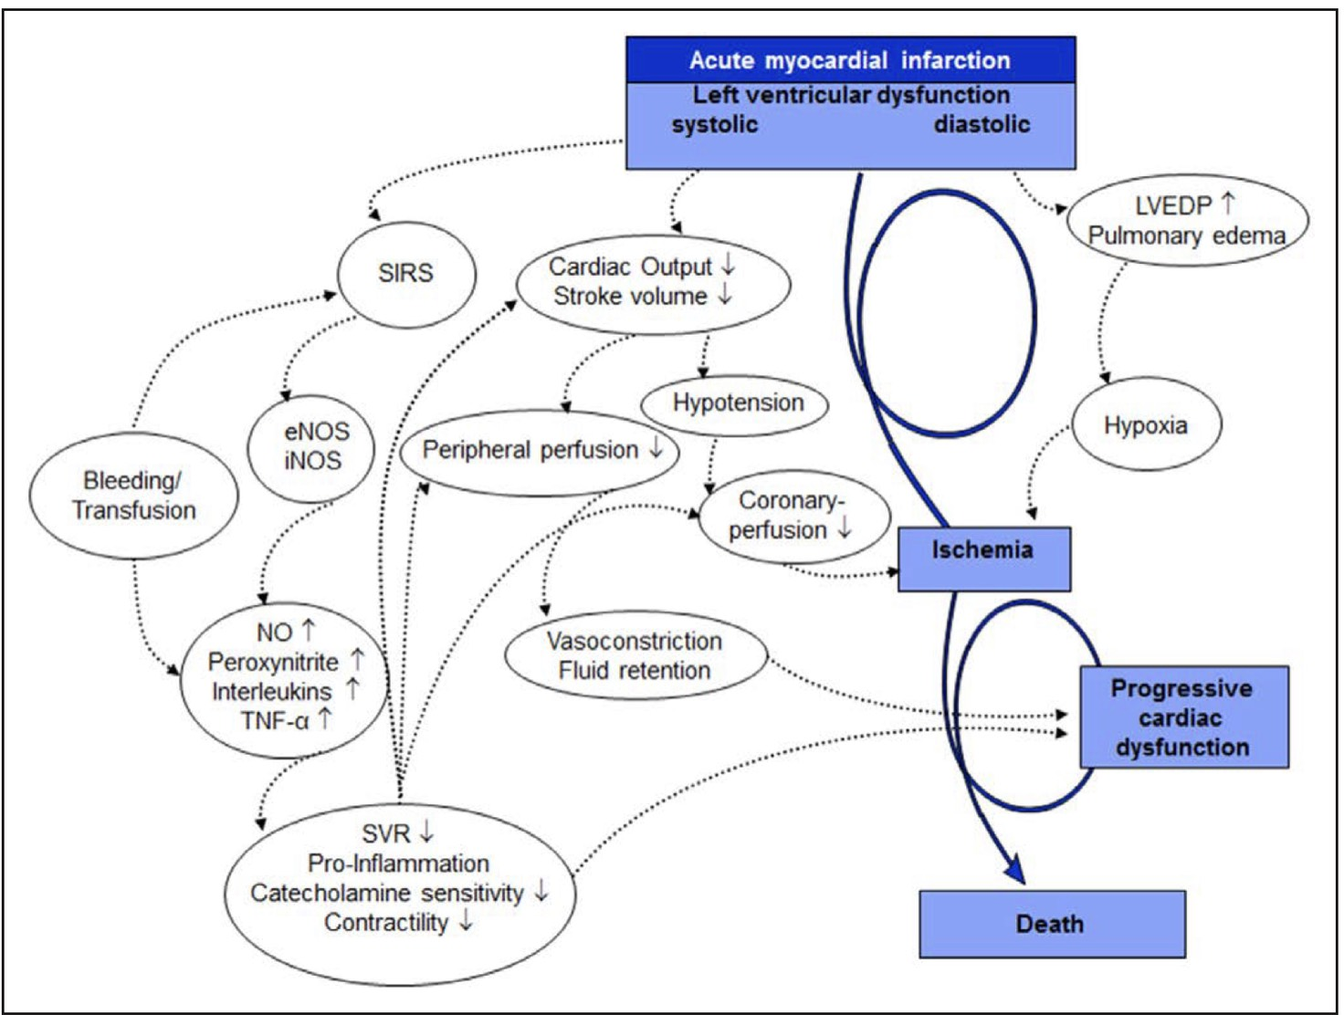
Cardiogenic shock

Slide 25
Cardiogenic shock

Slide 26
Cardiogenic shock
MAP goal of >65 mm Hg.
Vasopressin has less pulmonary vasoconstriction than norepinephrine; and may be more beneficial as a first-line vasopressor in patients with CS with acute RVF.
Pulmonary vasoactivity can be modified by inodilators, phosphodiesterase III inhibitors, or nitric oxide.

Slide 30
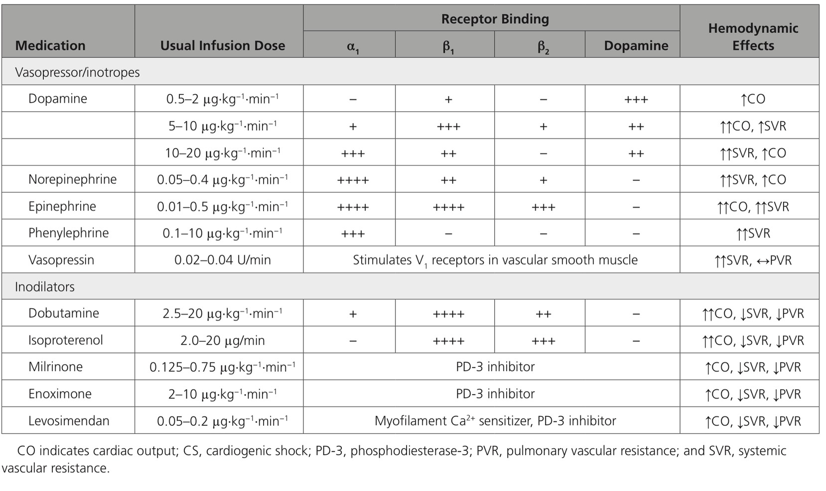

Slide 32
Vasopressors used in this setting include norepinephrine, high-dose dopamine (>5 micrograms/kg/min), and vasopressin, and these should be carefully titrated to achieve adequate perfusion of vital organs.

Slide 33
LV failure
LV systolic dysfunction with hypotension despite adequate preload
Inotropic
Vasodilatation with wide PP +/- Low SVR
Vasopressor
Evidence of diastolic dysfunction
Milrinone

Slide 34
temporizing measure in patients with severe LV systolic dysfunction and low output syndrome (diminished peripheral perfusion and end-organ dysfunction)
maintain systemic perfusion and preserve end-organ performance until definitive therapy is instituted or resolution of the acute precipitating problem has occurred.
Continuous intravenous inotropic support was felt to be reasonable as “bridge therapy” in patients with stage D HF refractory to guideline-directed medical therapy and device therapy who are eligible for and awaiting mechanical circulatory support or cardiac transplantation.
In addition, the guidelines noted that inotropic therapy “may be reasonable” (a very weak recommendation) in the following settings: short-term, continuous intravenous inotropic support in hospitalized patients presenting with documented severe systolic dysfunction who present with low blood pressure and significantly depressed cardiac output to maintain systemic perfusion and preserve end-organ performance; and long-term continuous intravenous inotropic support as palliative therapy for symptom control in select patients with stage D HF despite optimal guideline-directed medical therapy and device therapy who are not eligible for either mechanical circulatory support or cardiac transplantation.
Inotropes are not indicated for treatment of ADHF in the setting of preserved systolic function.

Slide 35
In patients with ADHF and marked hypotension, vasopressor therapy can be used as a temporizing measure to preserve systemic blood pressure and end-organ perfusion, although at the cost of increasing afterload and decreasing cardiac output [19]. Vasopressor use should be limited to patients with persistent hypotension with symptoms or evidence of consequent end-organ hypoperfusion despite optimization of filling pressures and use of inotropic agents as appropriate. In this setting, invasive monitoring can be helpful to assess filling pressures and systemic vascular resistance. (See "Pulmonary artery catheterization: Indications, contraindications, and complications in adults", section on 'Indications'.)Vasopressors used in this setting include norepinephrine, high-dose dopamine (>5 micrograms/kg/min), and vasopressin, and these should be carefully titrated to achieve adequate perfusion of vital organs (table 3). Dopamine and norepinephrine have beta inotropic as well as vasopressor activity. (See "Use of vasopressors and inotropes".)
A systematic review found no evidence to determine the clinical efficacy and safety of vasopressor therapy in ADHF [14].

Slide 36
Treatment of patients with HFrEF and hypotension is guided by hemodynamics, which are most commonly imputed from the physical examination with more direct assessment by right heart catheterization performed when required for selected cases. If the systolic blood pressure is <85 mmHg or there is evidence of shock (eg, cool extremities, narrow pulse pressure, low urine output, confusion) and evidence of adequate preload, the addition of an inotrope is suggested [19]. In patients with persistent shock, a vasopressor may be needed as a temporizing measure to support perfusion to vital organs, though this is at the expense of increased LV afterload. Selected patients with hypotension may benefit from vasodilator therapy guided by invasive monitoring, including pulmonary artery catheter. For selected patients with severe HFrEF (generally with LVEF <25 percent) with acute, severe hemodynamic compromise, nondurable mechanical support (eg, intra-aortic balloon pump [IABP], extracorporeal circulatory membrane oxygenator [ECMO], or extracorporeal ventricular assist devices) is an option as a "bridge to decision" or "bridge to recovery" [5,19].Patients with HFpEF presenting with hypotension should not receive inotropic therapy and may require a vasopressor . Assessment of the intravascular volume status is critical in such patients to determine the need for diuresis and/or hydration. For patients who develop hypotension with dynamic LV outflow obstruction, treatment may include a beta blocker, a vasopressor (eg, phenylephrine or norepinephrine), and gentle hydration if pulmonary edema is not present. Dynamic LV outflow obstruction occurs in some patients with hypertrophic cardiomyopathy but is not limited to patients with that condition. (See "Hypertrophic cardiomyopathy: Medical management for non-heart failure symptoms", section on 'Acute hemodynamic collapse in the setting of LVOT obstruction'.)

Slide 37
RV failure
RV systolic dysfunction with hypotension despite adequate preload
Inotropic
Persistent hypotension with evidence of vasodilatation with decrease coronary perfusion
Vasopressor +/- Inodilator
Persistent hypotension & PVR is elevated
Pulmonary vasodilator or Milrinone (add vasopressor)

Slide 38
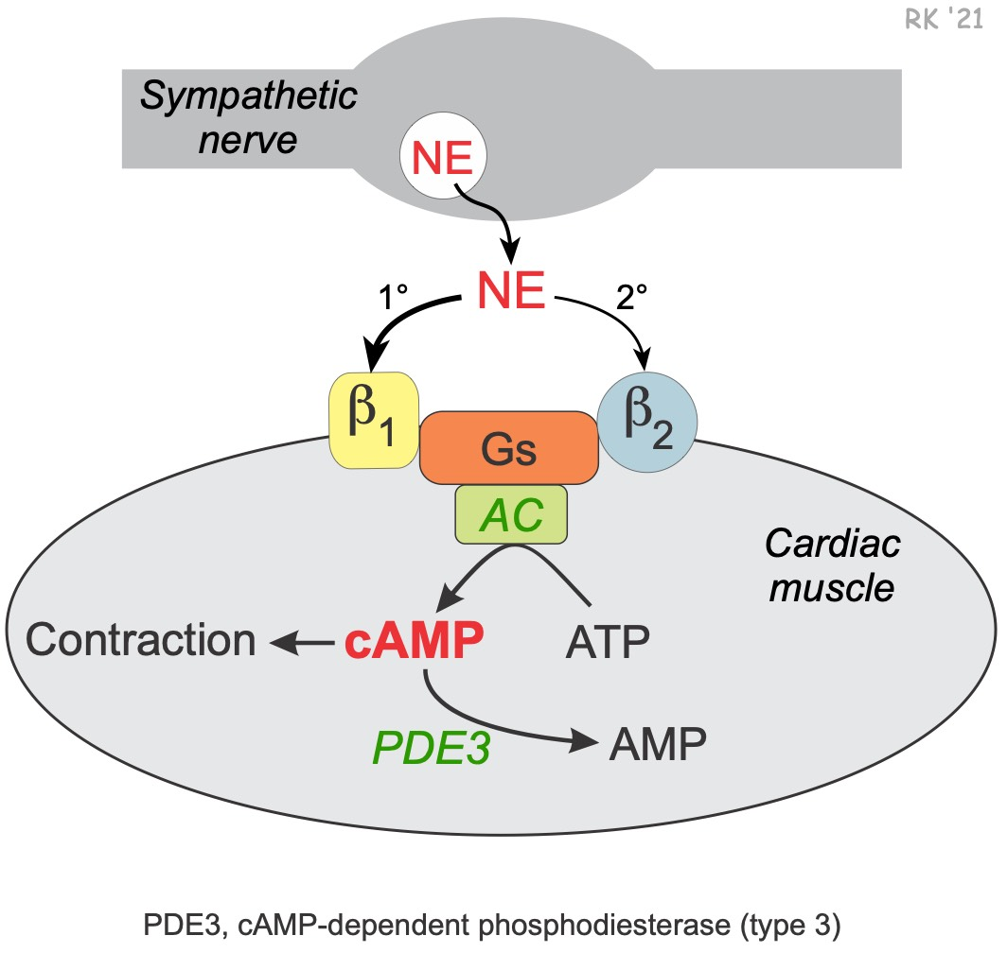
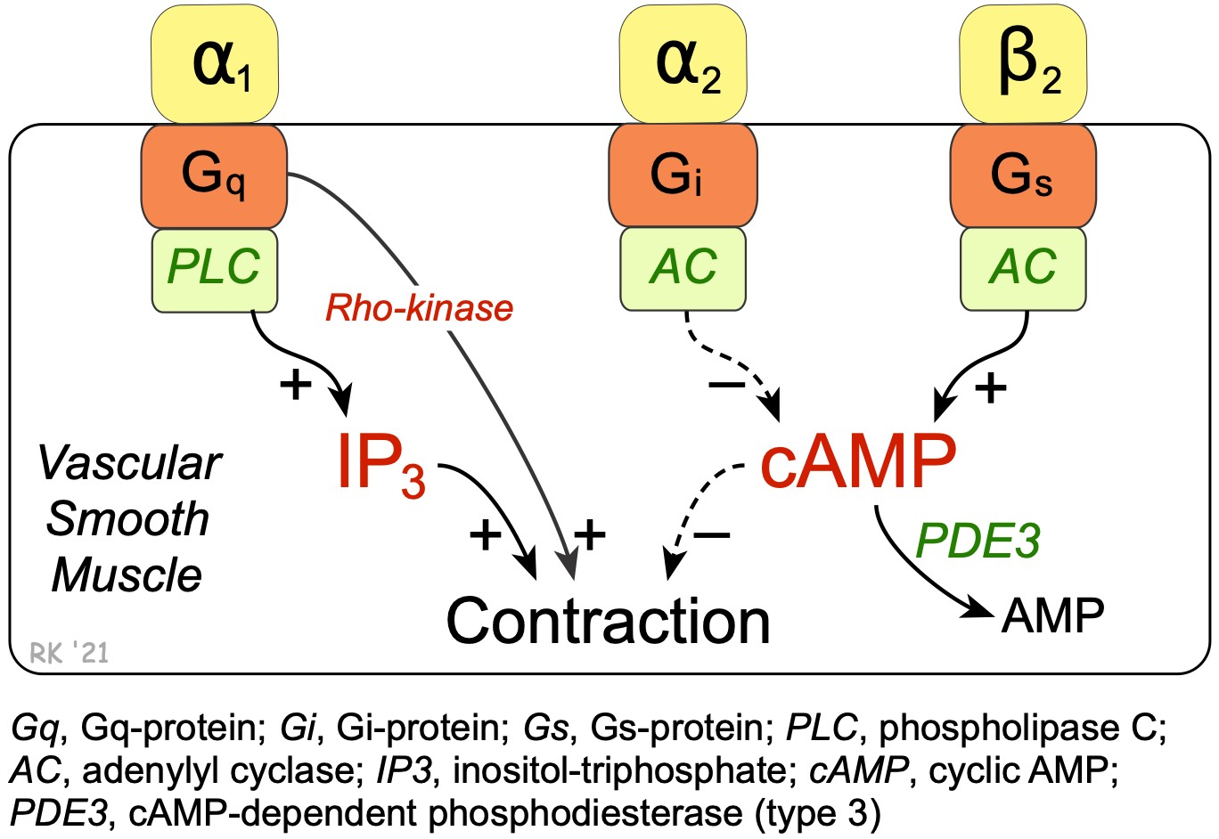
Phosphodiesterase Inhibitors

Slide 39
Milrinone
PDE III inhibitors
Inotropic support during and after cardiac surgery.
Milrinone enhances myocardial contractility and causes arterial and venous vasodilation
Milrinone : increase cardiac output and oxygen delivery
- Loading doses : 25 or 50 mcg/kg
- Infusion rates : 0.375 - 0.75 mcg/kg/min

Slide 40
Phosphodiesterase Inhibitors
Contraindicated : treatment of chronic heart failure
Treatment : acute LV dysfunction during cardiac surgery and in ICU.

Slide 41
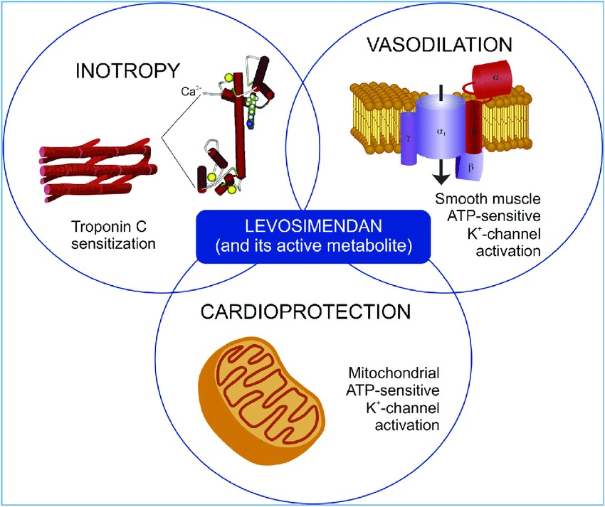
Levosimendan

Slide 42
Levosimendan
Myofilament Ca2+ sensitizers are positive inotropic, vasodilating drugs that enhance myocardial contractility by increasing the Ca2+ sensitivity of the contractile apparatus.
Levosimendan is used extensively in Europe for short-term treatment of heart failure and for inotropic support in patients undergoing cardiac surgery.
Levosimendan produced rapid improvement of symptoms in patients with acute decompensated heart failure, but the drug also increased the risk of cardiovascular-related complications.
Levosimendan also improves cardiac performance concomitant with reductions in pulmonary capillary occlusion pressure and systemic vascular resistance in patients with normal and depressed LV systolic function undergoing cardiac surgery.
Levosimendan has a biologically active metabolite (OR-1896) that most likely contributes to the parent drug’s more prolonged hemodynamic effects compared with catecholamines or PDE III inhibitors.

Slide 43
Levosimendan
Inodilator
Pharmacological effects:
a) Increased cardiac contractility mediated by calcium sensitisation of troponin C
b) Vasodilation through the opening of potassium channels on the sarcolemma of smooth muscle cells in the vasculature
c) Cardioprotection through the opening of mitochondrial potassium channels in the cardiomyocytes

Slide 44
Levosimendan
Short-term treatment of acutely decompensated severe chronic heart failure
Most common adverse events : hypotension, headache, atrial fibrillation, hypokalaemia and tachycardia.
Positive effects in conditions requiring inotropic support : RV failure, cardiogenic shock, and septic shock

Slide 45
Levosimendan is indicated for the short-term treatment of acutely decompensated severe chronic heart failure in situations where conventional therapy is not sufficient, and in cases where inotropic support is considered appropriate.
In the latest decade, however, levosimendan has been studied in numerous clinical trials outside the field of acute heart failure. Primarily, the drug has been tested in the cardiac surgery settings , field in which the drug has shown beneficial haemodynamic and cardioprotective effects and a favorable outcome effect.
In addition, several studies with repetitive levosimendan dosing in patients suffering from advanced chronic heart failure have shown beneficial effects on haemodynamics, neurohormone levels and symptoms.
Finally, levosimendan has also shown preliminary positive effects - mainly in small-scale studies - in right ventricular failure, cardiogenic shock, septic shock, Takotsubo cardiomyopathy, and in other states requiring inotropic support [32, 33].
Our aim is to review the current data, clinical use and future development of levosimendan in all therapy settings envisioning the future development for this drug, the first in class of the cardioprotective inodilators.

Slide 46
The therapeutic dose range of levosimendan administered over a 24-h period was identified in a, double-blind, placebo-controlled study including 151 patients with stable (mainly NYHA class III) heart failure of ischaemic origin.
Patients were treated with a bolus dose of levosimendan of 3-36 µg/kg in 10 min followed by a 24-h intravenous infusion at doses ranging from 0.05 to 0.6 μg/kg/min

Slide 47
Right ventricular failure
Most commonly related to LV failure
Can be caused by myocardial ischemia, volume overload and/or pressure overload
Levosimendan has been shown to:
1) Reduce the increased RV afterload
2) Improve RV contractility
3) Improve diastolic function of the RV

Slide 48
Cardiogenic shock
Profound depression of myocardial contractility and the state can be defined as decreased cardiac output and evidence of tissue hypoxia in the presence of adequate intravascular volume.
The standard of care consists of primary percutaneous coronary intervention for ST-elevated myocardial infarction, fluid therapy, vasopressors and inotropes.
Data describing the use of levosimendan in cardiogenic shock are still scarce.
Improve some haemodynamic and ventricular indices.

Slide 49
●Milrinone – Milrinone is a phosphodiesterase inhibitor that increases myocardial inotropy by inhibiting degradation of cyclic adenosine monophosphate. Milrinone is also a potent arterial and venous dilator due to inhibition of vascular smooth muscle phosphodiesterase, leading to decreases in systemic and pulmonary vascular resistance, and right and left heart filling pressures [26,27]. Together these effects lead to an increase in cardiac index and decreases in LV afterload and filling pressures. Patients should receive a loading dose of 50 mcg/kg over 10 minutes, followed by a maintenance dose of 0.375 to a maximum of 0.750 mcg/kg per min. Dose adjustment is required in the presence of renal insufficiency, hypotension, or arrhythmias.Since milrinone does not act via beta receptors, its effects are not as diminished as those of dobutamine or dopamine by concomitant beta blocker therapy.
●Dobutamine – Dobutamine acts primarily on beta-1 adrenergic receptors, with minimal effects on beta-2 and alpha-1 receptors. The hemodynamic effects of dobutamine include increases in stroke volume and cardiac output, and modest decreases in systemic vascular resistance and pulmonary capillary wedge pressure [28,29]. It should be started at 2.5 mcg/kg per min and, if tolerated and needed, can be gradually increased to 20 mcg/kg per min.
●Dopamine – At low doses of 1 to 3 µg/kg per min, dopamine acts primarily on dopamine-1 receptors to dilate the renal and mesenteric artery beds [30]. At 3 to 10 µg/kg per min (and perhaps also at lower doses), dopamine also stimulates beta-1 adrenergic receptors and increases cardiac output, predominantly by increasing stroke volume with variable effects on heart rate. At medium-to-high doses, dopamine also stimulates alpha-adrenergic receptors, although a small study suggested that renal arterial vasodilation and improvement in cardiac output may persist as the dopamine dose is titrated up to 10 µg/kg per min [30].Although it has been proposed that dopamine might improve renal function in patients with severe HF by increasing renal blood flow and possibly by reducing renal venous pressure, data supporting such a potential benefit are limited. Specifically, the addition of low-dose dopamine to diuretic therapy was not found to enhance decongestion or improve renal function [31]

Slide 50
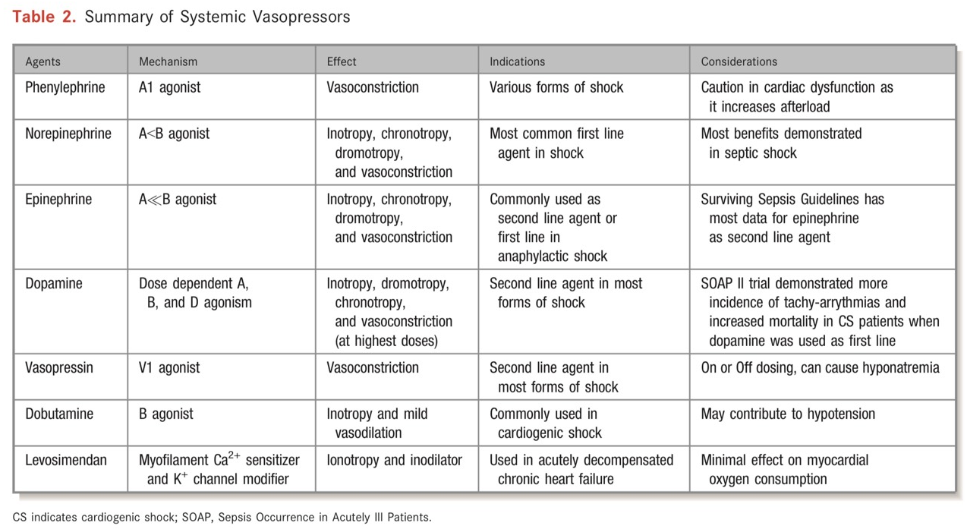

Slide 52
Pulmonary hypertension
Vasoconstrictors such as norepinephrine, vasopressin, phenylephrine, or metaraminol can effectively maintain coronary perfusion pressure in response to decreasing SVR from induction agents.
In a recent study of patients with PH un- dergoing non-cardiac surgery, a perioperative vasopressor was used in 82% of cases.
Norepinephrine (up to 0.5 mg kg1 min1) is a first-line treatment in most centres and improves coronary blood flow in models of RV failure.
Low-dose vasopressin may be a particularly useful selective systemic vasoconstrictor in this setting, as an infusion or even a bolus in a PH crisis to augment SVR without adverse effects on PVR.
In terms of inotropes, beta1-adrenergic receptor agonists such as dobutamine or dopamine can improve RV performance, before (pre-emptive), after anaesthetic induction, and into recovery; however, tachycardia and arrhythmias can be an undesirable effect.
No evidence suggests that one catecholamine is superior to another for PH and RV dysfunction.
Inodilators or lusitropes such as milrinone or enoximone are useful, providing diastolic augmentation, but because of their dilatation effect, are often co-administered with a vasopressor.

Slide 53
Treatment of exacerbations of RV dysfunction and/or PH
Inotropes : improve the contractility of the RV and LV during the perioperative period
Inodilators such as milrinone or dobutamine : support RV contractility.
Dobutamine may improve ventricular-vascular coupling.
Used in combination with vasopressors to increase coronary perfusion pressure

Slide 54
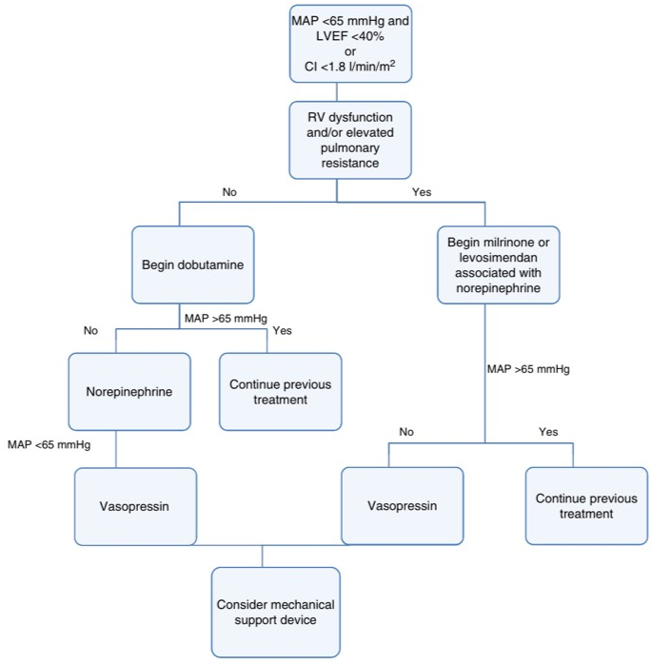

Slide 55
Treatment of exacerbations of RV dysfunction and/or PH
Vasopressors : maintain RV perfusion pressure : 1st line of support for RV dysfunction and treatment of acute decompensation.
Norepinephrine or vasopressin may reduce the PVR to SVR ratio more successfully than high doses of phenylephrine, which can cause unopposed pulmonary vasoconstriction as well as reflex bradycardia
Low-dose vasopressin infusion actually decreases PVR through release of nitric oxide from the pulmonary vascular endothelium and activation of the V2 receptors in vascular smooth muscle
Low-dose infusion vasopressin in PH and RV failure = 0.03 - 0.07 units/minute

Slide 56
Treatment of exacerbations of RV dysfunction and/or PH
Epinephrine supports the systemic circulation, but increases PVR -> associated tachycardia, proarrhythmic effects, and increased myocardial oxygen consumption
Epinephrine is typically reserved for severe refractory cardiogenic shock.
Calcium sensitizers, such as levosimendan, are inodilators that increase myocardial sensitivity to calcium, thereby increasing cardiac contractility, and these agents also open adenosine triphosphate channels in vascular smooth muscle which causes vasodilation.
Levosimendan is often used in the perioperative treatment of PH and RV failure in countries where it is available, although consistent evidence of benefit is lacking

Slide 57
Obstructive shock
Pulmonary vascular
Pulmonary embolism, Venous air embolism, Severe or acute pulmonic or tricuspid obstruction
Mechanical
Tension pneumothorax, Pericardial tamponade, Constrictive pericarditis, Restrictive cardiomyopathy, Abdominal compartment syndrome, Aortocaval compression, Left or right ventricular outflow tract obstruction

Slide 58
Obstructive shock
Administration of fluids or vasopressors does not correct the cause of obstructive shock, but may provide temporary hemodynamic stability to allow definitive surgical treatment

Slide 59
Massive Pulmonary embolism

Slide 60
Massive Pulmonary embolism
●Vasopressors –
Intravenous vasopressors are administered when adequate perfusion is not restored with IVF.
Options include:
•Norepinephrine –it is effective and less likely to cause tachycardia. Other alternatives include dopamine and epinephrine, but tachycardia, which can exacerbate hypotension, can occur with these agents .
•Dobutamine – Dobutamine is sometimes used to increase myocardial contractility in patients with circulatory shock from PE. However, it also results in systemic vasodilation which worsens hypotension, particularly at low doses [23,24]. To mitigate this effect, we typically initially add norepinephrine to dobutamine; as the dose of dobutamine is increased, the effects of dobutamine-induced myocardial contractility exceed those of vasodilation, potentially allowing norepinephrine to be weaned off.

Slide 61
Vasopressors and Inotropes: Early use of vasopressors and inotropes can help enhance RV function.
Norepinephrine would be an ideal agent as it helps increase MAP, improve RV function, without increasing pulmonary vascular pressures.
Dobutamine and milrinone can help improve RV function and cardiac output while decreasing pulmonary vascular resistance.
The main issue with these agents is they are vasodilatory and can worsen hypotension and should be used in conjunction with vasopressors.
Pulmonary Vasodilators: Inhaled nitric oxide (NO) is very promising in the management of RV failure. Physiologically, it decreases pulmonary vascular resistance without reducing systemic pressures. It also appears to improve ventilation-perfusion mismatch
Initial Resuscitation Summary: Escalating Therapy – Start with gentle hydration (500 mL), then consider the addition of a vasopressor early, followed by an inotrope. If the patient is still hemodynamically unstable, consider adding inhaled NO.

Slide 62
Massive Pulmonary embolism
Early use of vasopressors and inotropes can help enhance RV function.
Norepinephrine : ideal agent -> increase MAP, improve RV function, without increasing pulmonary vascular pressures.
Dobutamine and milrinone :
help improve RV function and cardiac output while decreasing pulmonary vascular resistance.
They are vasodilatory and can worsen hypotension and should be used in conjunction with vasopressors.

Slide 63
LVOT
Replete Volume
Alpha-1 agonist : Phenylephrine
Titrate beta blocker
AVOID INOTROPE

Slide 64
The general perioperative haemodynamic goals are listed below.
(i) Preload: Expand intravascular volume in order to augment or at least maintain preload (despite the high central venous pressure observed in tamponade physi- ology, which essentially is a reflection of chamber compression and not the true filling pressure). This is of particular importance in patients with coexisting depletion of circulating volume.
(ii) Heart rate and rhythm: Avoid bradycardia, and treat any bradycardias promptly if they occur. Maintain sinus rhythm so that cardiac output remains optimal.
(iii) Afterload: Maintain systemic vascular resistance (SVR), which is high in patients with tamponade because of high sympathetic nervous activity). It is essential that the compensatory cardiovascular mechanisms (tachy- cardia and raised SVR) are maintained during induction of anaesthesia.
(iv) Contractility: Maintain optimal contractility, and avoid myocardial depressants.
The haemodynamic goals can be summarised as ‘fast, full, and squeezed tight’.In patients who

Slide 65
These include vasopressors (either metaraminol or phenylephrine boluses, and an infusion of noradrenaline [norepinephrine]) and inotropes (adrenaline [epinephrine]). Defibrillator pads should be attached before induction.

Slide 66
Hypertensive emergency & urgency in OR
The goal of therapy is to halt the vascular damage, not to normalize the BP.
Reducing systolic BP by 10 - 15% or up to 25% within the 1st hour.
Followed by gradual reduction of BP to 160/110 mmHg over the following 2-6 hours.

Slide 67
Rational approach to the management of hypertensive crises
Neurological emergencies
Cardiovascular emergencies
Pheochromocytoma
Pre-eclampsia/eclampsia

Slide 68
Neurological emergencies
Subarachnoid haemorrhage, acute intracerebral haemorrhage, and acute ischemic stroke require rapid BP reduction.
For acute ischemic stroke, the preferred medications are Labetalol and Nicardipine.
The target BP is < 185/110 mm Hg especially if the patient is receiving fibrinolysis.
In subarachnoid haemorrhage, Nicardipine, Labetalol and Esmolol are preferred
Maintain the SBP < 160 mm Hg until the aneurysm is treated or cerebral vasospasm happens.
AVOID Nitroprusside and Hydralazine.

Slide 69
Neurological emergencies
In acute intracerebral haemorrhage, Labetalol, Nicardipine and Esmolol are preferred
If signs of increased ICP exist, keep SBP < 180 mm Hg, for the first 24 hours after onset of symptoms.
Patients without increased ICP, maintain SBP < 160 mm Hg for the first 24 hours after onset of symptoms.
Early intensive BP control is recommended to reduce hematoma growth.
AVOID Nitroprusside and Hydralazine.

Slide 70
Cardiovascular emergencies
Cardiovascular emergencies such as aortic dissection and acute coronary syndrome : Rapid BP reduction
Labetalol, Nicardipine, Nitroprusside (with beta-blocker), & Esmolol are preferred in aortic dissection.
Keep the SBP < 110 mmHg unless signs of end-organ hypoperfusion exists.

Slide 71
Cardiovascular emergencies
In acute coronary syndrome if the BP is >160/100 mm Hg,
Nitroglycerin and beta blockers are used to lower the BP by 20- 30% of baseline but, thrombolytics are avoided if the BP is >185/100 mm Hg.

Slide 72
Pheochromocytoma
Nitroprusside 1st line drug : arterial vasodilatation
Nitroglycerin are the preferred drugs.
Phentolamine : competitive alpha1 and weak alpha2 adrenergic receptor antagonist
In pheochromocytoma, beta blockers can be added after alpha blockade for BP control.

Slide 73
Pre-eclampsia/eclampsia
Hydralazine 1st line drugs : Direct vasodilate
Labetalol Nifedipine and Nicardipine : alternative
AVOID Nitroprusside and Esmolol
Target the perioperative BP to within 15-25% of the patient's baseline pressure.
Target SBP ~ 120 – 160 mmHg and DBP 80 -105 mmHg

Slide 74
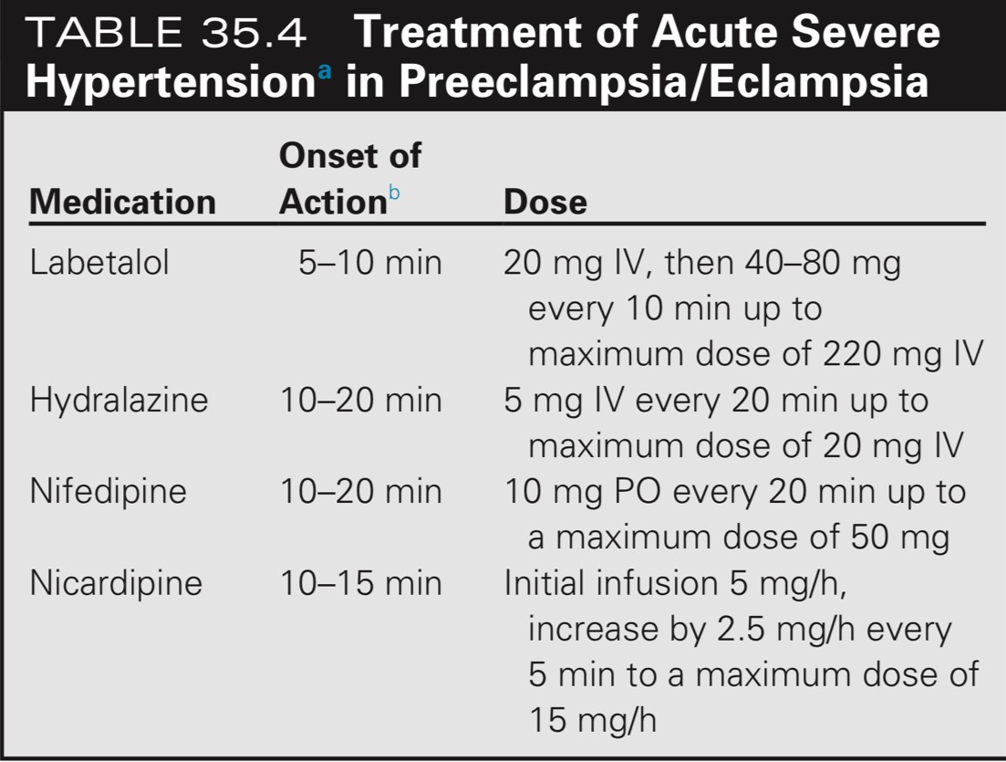
Pre-eclampsia/eclampsia

Slide 75
Post-induction hypotension
Hypotension is the most common hemodynamic perturbation requiring intraoperative treatment.
Selection and dosing of anesthetic agents
Selection of anesthetic agents and techniques, as well as dosing adjustments, may be employed to prevent or treat episodes of hypotension.

Slide 76
Organ perfusion
BP = CO x SVR
= ( SV X HR ) X SVR
= ( EDV – ESV ) X HR X SVR
= EDV ( EDV – ESV ) X HR X SVR
EDV
= EDV X EF X HR X SVR

Slide 77
Ephedrine
Treat acute decreases in BP
Alpha, beta1, and beta2 receptors
IV bolus 5 to 10 mg
Ephedrine : predominantly indirect effects on adrenergic receptors -> causes presynaptic release of norepinephrine and may have additional effects on postsynaptic release and inhibition of norepinephrine uptake
Beta effects of ephedrine result in increased HR via sinoatrial node stimulation and increased inotropy, while its alpha effects cause peripheral vasoconstriction.

Slide 78
•Advantages-Increases BP and CO and HR with beneficial hemodynamic effects in most patients, particularly if bradycardia originates within or above the atrioventricular node (eg, due to beta blocking agents).-
Ephedrine has bronchodilating beta2 effects, which can be of benefit in the setting of perioperative bronchospasm
-Duration of action of ephedrine is typically longer than equipotent small bolus doses of epinephrine.
-Ephedrine may better preserve cerebral blood flow and cerebral oxygenation compared with phenylephrine
•Disadvantages
-Tachyphylaxis may occur in patients with depleted stores of endogenous norepinephrine (eg, those with hemorrhagic shock) and may occur with repeated doses. Typically, another agent is added or substituted for ephedrine after 50 to 60 mg have been administered
.-Drugs that block ephedrine uptake into adrenergic nerves (eg, cocaine) and those that deplete norepinephrine reserves (eg, reserpine) attenuate the cardiovascular effects of ephedrine.
-In patients using monoamine oxidase inhibitors or certain drugs of abuse, such as methamphetamines, ephedrine should be avoided or administered with extreme caution (eg, in small incremental doses of 2.5 mg), due to the potential for an exaggerated hypertensive response or life-threatening dysrhythmias.
-In obstetrical anesthesia, use of ephedrine may be associated with increased risk of fetal acidosis
-Either ephedrine or phenylephrine, by virtue of their synthetic origin, may rarely cause allergic reactions, such as contact allergic responses with topical use (eg, during ophthalmologic surgery), and delayed severe dermatitis following IV injection has been reported
-Ephedrine cannot be administered as a continuous infusion.

Slide 79
Phenylephrine
Selected to treat hypotension if normal or elevated HR is present
Exclusively stimulates alpha1 adrenergic receptors, and is usually associated with baroreceptor reflex-mediated decreases in HR.
Bolus doses (eg, 50 to 100 mcg) or as a continuous infusion at 10 to 100 mcg/min

Slide 80
.•Advantages-A decreased or stable HR is desirable in patients with ischemic heart disease
-Agents with primarily alpha agonist properties, such as phenylephrine, are best initial treatment options for hypotension in patients with LV outflow tract obstruction, aortic stenosis, or tetralogy of Fallot.
-Phenylephrine may be administered as a bolus or as a continuous infusion.
•Disadvantages-Individual responses may be variable, and there are ethnic variations in vascular responsiveness to phenylephrine .
Genomic studies of polymorphisms of the beta-2 adrenergic receptor suggest that Gly16 carriers may require larger doses of intraoperative vasopressor (ephedrine or phenylephrine) likely due to association of the Gly16 allele with vasodilation and higher CO than other genotypes
-Alpha1 receptor-mediated vasoconstriction caused by phenylephrine typically reduces CO due to decreased stroke volume and arterial compliance.
Although ephedrine and norepinephrine also cause arterial vasoconstriction, both are more likely to increase CO compared with phenylephrine, due to positive inotropic effects (as well as increased HR when ephedrine is selected
However, the CO responses to either phenylephrine or norepinephrine have been shown to depend on baseline intravascular volume status and evidence of fluid responsiveness
-The effects of alpha-mediated vasoconstriction on splanchnic blood volumes and venous return are unclear
-Patients with impaired ventricular function and chronic heart failure may have decreased alpha1 receptor responsiveness limiting the effectiveness of phenylephrine.
-For patients with aortic or mitral regurgitation, vasoconstriction and decreases in HR are detrimental.
-As with ephedrine, rare localized allergic reaction may occur.

Slide 81
●Vasopressin and terlipressin
– Vasopressin is typically used for treatment of hypotension that is refractory to administration of catecholamines or sympathomimetics, particularly for patients with vasodilatory shock (eg, septic shock).
It is often added as a supplementary agent to treat hypotension after an inadequate response to other vasopressors.
Vasopressin is a naturally-occurring nonapeptide essential for maintenance of plasma osmolality due to its antidiuretic actions.
It also acts as a vasoconstrictor by stimulating the nonadrenergic V1 receptor if administered in supraphysiologic concentrations (eg, bolus doses of 1 to 4 units or as a continuous infusion at 0.01 to 0.04 units/minute).
Higher vasopressin doses up to 0.1 units/minute are reserved for instances when a MAP goal cannot be achieved with lower vasopressin doses in combination with other vasopressor agents [62].
Although efficacy of vasopressin is relatively equivalent to equipotent doses of epinephrine in producing profound arterial vasoconstriction during resuscitation, high bolus doses (ie, 40 units) are no longer recommended as an alternative to epinephrine in the American Heart Association (AHA) advanced cardiovascular life support algorithm for cardiac arrest due to efforts by the AHA to simplify this algorithm (algorithm 1). (See "Use of vasopressors and inotropes", section on 'Vasopressin and analogs' and "Intraoperative management of shock in adults", section on 'Distributive shock management'.)
Terlipressin is a synthetic prodrug analog of vasopressin that is not available in the United States.
Compared with vasopressin, terlipressin has a considerably longer half-life (six hours) and greater selectivity for the V1 receptor [62]. Due to its selective splanchnic arteriolar vasoconstrictive effects, terlipressin is typically used to decrease esophageal variceal bleeding, or to treat portal hypertension and hepatorenal syndrome. (See "Methods to achieve hemostasis in patients with acute variceal hemorrhage", section on 'Terlipressin' and "Hepatorenal syndrome", section on 'Terlipressin plus albumin where available'.)•Advantages-Vasopressin is effective for treatment of hypotension refractory to administration of catecholamines or sympathomimetics (eg, ephedrine, phenylephrine, norepinephrine). Examples include vasoplegia due to chronic administration of angiotensin-converting enzyme inhibitors, prolonged cardiopulmonary bypass, or sepsis [62,63].-Vasopressin has no direct effects on HR; a slower HR is desirable in patients with ischemic heart disease (table 1). (See "Anesthesia for noncardiac surgery in patients with ischemic heart disease", section on 'Prevention of ischemia'.)-Vasopressin has no vasoconstrictive effect on pulmonary arteries; thus, it is the preferred agent in patients with pulmonary hypertension [64-66]. (See "Anesthesia for patients with pulmonary hypertension or right heart failure", section on 'Vasopressors and inotropes'.)-An agent with pure vasoconstrictor activity such as vasopressin is the best option for patients with LV outflow tract obstruction, aortic stenosis, or tetralogy of Fallot when treatment with a vasopressor is necessary. (See "Anesthesia for patients with hypertrophic cardiomyopathy undergoing noncardiac surgery" and "Anesthesia for noncardiac surgery in patients with aortic or mitral valve disease", section on 'Hemodynamic management' and "Anesthesia for adults with congenital heart disease undergoing noncardiac surgery", section on 'Right-to-left shunt with cyanosis'.)-Vasopressin may be administered either as a bolus or as a continuous infusion.•Disadvantages-Peripheral extravasation of vasopressin can cause skin necrosis [67].-The half-life of vasopressin is longer than that of phenylephrine or catecholamine agents (ie, norepinephrine, epinephrine). Thus, vasopressin is more difficult to titrate.-Vasopressin is usually avoided in patients with neurologic injury and in those undergoing craniotomy because it can cause cerebral vasoconstriction [68]. However, it may be used if hypotension is refractory to adrenergic agents. (See "Anesthesia for craniotomy", section on 'Vasoactive drugs'.)-Since vasopressin and particularly terlipressin cause selective splanchnic arteriolar vasoconstriction, these agents are used cautiously in patients at risk for splanchnic hypoperfusion [62].

Slide 82
Norepinephrine
Endogenous catecholamine.
IV bolus doses of 4 to 8 mcg or IV infusion 0.05 – 0.4 mcg/kg/min

Slide 83
Norepinephrine
•Advantages-
Owing to its positive inotropic effects, norepinephrine will maintain or increase CO in most patients, while simultaneously causing arterial vasoconstriction and increasing blood pressure.
-Compared with phenylephrine, 8 mcg norepinephrine is approximately equal to 100 mcg of phenylephrine .
At comparable doses, norepinephrine is more likely to increase BP without significantly decreasing stroke volume or arterial compliance.-
Often selected as a first-line agent during noncardiac surgery, particularly for treatment of most types of shock. (See "Intraoperative management of shock in adults".)
-Limited data also support the safety and efficacy of norepinephrine in obstetrical anesthesia .
-Norepinephrine may be administered either as a bolus or as a continuous infusion.

Slide 84
Norepinephrine
•Disadvantages
-Like phenylephrine, norepinephrine-induced alpha1 receptor-mediated vasoconstriction may reduce CO in some patients. However, in patients who demonstrate fluid responsiveness, administration of norepinephrine can increase CO due to greater venous return and consequently increased preload, as well as its positive inotropic effects.
-A central venous catheter or peripherally inserted central catheter is usually employed for prolonged administration of norepinephrine due to concern regarding tissue damage if peripheral extravasation occurs.
However, since small doses of norepinephrine (approximately 10 mcg total) may be effective for initial treatment of hypotension, dilute solutions containing norepinephrine 4 to 8 mcg/mL may be administered as a bolus when necessary .
Furthermore, in a retrospective study that included 14,385 patients who received an infusion of diluted norepinephrine (20 mcg/mL) via a peripheral IV catheter, a low incidence of extravasation was observed in five patients (0.035 percent, 95% CI 0/011-0.081 percent), with zero complications requiring surgical or medical intervention .
Other reviews have also noted that dilute solutions of norepinephrine and other vasopressors rarely cause tissue damage when administered through a free-flowing large-bore peripheral IV catheter.
The optimal position in the arm for a peripheral IV catheter is the basilic or cephalic vein.
In a systematic review of 325 extravasation and local tissue injury events occurring during vasopressor infusions in critically ill patients, more than 85 percent occurred at an infusion site located distal to the antecubital fossa in the upper extremity, or distal to the popliteal fossa in the lower extremity.
Although catheterization of a vein directly in the antecubital fossa may be used, this position has the potential for penetration of the vein with arm flexion and is avoided if possible.

Slide 85
Epinephrine
– Epinephrine administration as a first-line agent to treat intraoperative hypotension is typically reserved for treatment of anaphylaxis or cardiac arrest
However, it may be used safely as a low dose bolus drug to treat hypotension, typically with doses of 8 to 16 mcg.
At low-dose infusions of approximately 1 to 2 mcg/minute (ie, 0.01 to 0.02 mcg/kg per minute in a 100 kg patient), epinephrine has primarily beta2 adrenergic effects; at these doses, epinephrine infusion has beneficial bronchodilatory effects and may cause arterial vasodilation with decreased BP.
At high doses of approximately 10 to 100 mcg/minute (ie, 0.1 to 1 mcg/kg per minute), epinephrine has primarily alpha adrenergic effects resulting in vasoconstriction with possible hypertension and adverse metabolic effects.
Intermediate dose ranges of approximately 2 to 10 mcg/minute (ie, 0.02 to 0.1 mcg/kg per minute) primarily cause both beta1 and beta2 adrenergic effects, resulting in increased BP and HR, as well bronchodilation.
However, individual responses to dose-related effect are variable.
•Advantages-Epinephrine is the first-line therapy for cardiac arrest and for anaphylaxis, and may be administered via an intramuscular route or through an endotracheal tube if IV access is lost during such emergencies.
-Epinephrine may be administered either as a bolus or as a continuous infusion.
•Disadvantages
-Titrating the balance between the alpha and beta receptor effects of epinephrine can be challenging because individual responses to dose-related effects are variable.
-Large bolus doses of epinephrine can cause profound hypertension due to its alpha effects, particularly if a rapidly reversible cause of hypotension is treated shortly after epinephrine administration.
-Adverse metabolic effects of excessive beta2 stimulation include hyperglycemia, lipolysis, and metabolic acidosis (due to type B lactic acidosis).

Slide 86
Other vasopressor agents
●– Administration of other vasopressors may be initiated for vasoplegia that is unresponsive to high doses of norepinephrine and/or vasopressin [79].
Agents include methylene blue [80-82], angiotensin II [80,83-85], vitamin C [80,86], and hydroxycobalamin (table 5) [80-82], but none of these are the first line of treatment. (See "Intraoperative management of shock in adults", section on 'Distributive shock management'.)
●Other inotropic agents
– Infusions of other inotropic drugs may have been initiated to support the circulation and maintain or increase the blood pressure in critically ill patients before their arrival in the operating room.
Examples include dopamine, dobutamine, and milrinone (table 2).
Such infusions may be continued, but these agents are not used as first-line vasoactive choices to treat new intraoperative hypotension. (See "Intraoperative management of shock in adults".)

Slide 87
MANAGEMENT AFTER SPINAL INJECTION
Hemodynamic changes are common after spinal anesthesia;
BP and HR must be monitored closely & treated promptly.
Goal BP – The optimal goal for BP depends on the clinical setting and patient medical status.

Slide 88
MANAGEMENT AFTER SPINAL INJECTION
Hypotension : IV fluid administration & vasopressor
Ephedrine 5 - 10 mg IV boluses, repeated up to 50 mg
Phenylephrine 40 - 160 mcg IV bolus or infusion 20 - 200 mcg/minute
Severe bradycardia associated with hypotension :
Atropine 0.6 mg IV bolus

Slide 89
Ephedrine
Treat acute decreases in BP
Alpha, beta1, and beta2 receptors
IV bolus 5 to 10 mg
Ephedrine : predominantly indirect effects on adrenergic receptors -> causes presynaptic release of norepinephrine and may have additional effects on postsynaptic release and inhibition of norepinephrine uptake
Beta effects of ephedrine result in increased HR via sinoatrial node stimulation and increased inotropy
Alpha effects cause peripheral vasoconstriction.

Slide 90
Phenylephrine
Selected to treat hypotension if normal or elevated HR is present
Exclusively stimulates alpha1 adrenergic receptors, and is usually associated with baroreceptor reflex-mediated decreases in HR.
Bolus doses (eg, 50 to 100 mcg) or as a continuous infusion at 10 to 100 mcg/min

Slide 91
Take Home Message

Slide 92
SHOCK
Septic Shock
Vasopressor : Norepinephrine = 1st line
Anaphylactic Shock
Epinephrine = 1st line : Initial dose : 0.01 mg/kg of 1:1,000( 1 mg/ml) IM at anterolateral thigh ( 0.5 mg in adult, 0.3 mg in children )
Hypovolemic Shock
Crystalloid fluid resuscitation -> norepinephrine
Cardiogenic Shock
Obstructive Shock
Administration of fluids or vasopressors does not correct the cause of obstructive shock, but may provide temporary hemodynamic stability to allow definitive surgical treatment

Slide 93
Cardiogenic Shock

Slide 94
Management after initiation of epidural anesthesia
After the initiation of epidural anesthesia, patients require the same standard of monitoring required for general anesthesia. The adequacy of the epidural block should also be assessed prior to surgical incision. (See 'Assessment of level of block' below.)
Hemodynamic management — The hemodynamic changes that occur after initiation of epidural anesthesia are similar to the changes that occur with spinal anesthesia, although the onset of these changes is slower. The blood pressure (BP) and heart rate must be closely monitored, and clinically significant aberrations should be treated promptly.Blood pressure
●Monitoring – BP should be measured frequently after initiation of epidural anesthesia to facilitate rapid treatment of hypotension with fluids and vasopressors as needed. We measure BP every 2.5 minutes for the first 20 minutes and every five minutes thereafter, depending on hemodynamic stability and vasopressor requirement.
●Goal BP – The target BP depends on the patient's clinical status and the clinical scenario. As examples, in women undergoing cesarean delivery with epidural anesthesia, we aim to maintain systolic BP close to baseline because of concern for uteroplacental perfusion. A similar goal applies to patients with significant cardiovascular disease. However, in young, healthy patients undergoing lower extremity surgery, a systolic BP change 20 percent below the baseline would likely be safe and well tolerated.

Slide 95
Prophylaxis for hypotension
– Intravenous (IV) fluids mitigate the severity of epidural anesthesia-induced hypotension. The optimal timing of fluid administration (preload versus co-load) has not been studied in patients having epidural anesthesia [70]. We administer a rapid bolus of IV crystalloid solution at the time of epidural catheter placement/induction of anesthesia (co-load) [70], modified for patient factors (eg, reduced volume or speed of administration of IV fluid in patients at risk for pulmonary edema). Since the onset of hypotension is slower for epidural as compared with spinal anesthesia, prophylactic administration of vasopressors is not typically warranted.
●Treatment of hypotension – Hypotension can be treated with rapid IV fluid administration and vasopressor administration (eg, ephedrine 5 to 10 mg IV bolus, phenylephrine 50 to 100 mcg IV bolus, or phenylephrine infusion 0.20 to 0.75/mcg/kg/minute IV).\
Heart rate — Bradycardia, although uncommon following epidural anesthesia, should be treated promptly with atropine (0.4 to 0.6 mg IV) or glycopyrrolate (0.2 to 0.4 mg IV), and ephedrine (5 to 10 mg IV, repeated as needed up to 25 to 50 mg IV). If bradycardia is associated with hypotension, epinephrine (5 to 10 mcg IV) should be administered and repeated as required.
For severe bradycardia or cardiac arrest, advanced cardiac life support protocols should be initiated.
Hemodynamic management during epidural anesthesia for cesarean delivery is discussed in more detail separately. (See "Anesthesia for cesarean delivery", section on 'Hemodynamic management'.)

Slide 96
Thank you

